Slide 1
Sunshine Scoop
Good!
NEWS!
Sunshine Scoop: Your Daily Dose of Positivity!
Presented by Akshay Rajesh and Erjon Buka

Slide 2
TABLE OF CONTENTS
01
04
02
05
03
Introduction
Summarization
Data Cleaning
Next Steps
Sentiment Analysis

Slide 3

Introduction
About Us : We are The Fine Tuners.
Mission : Spreading joy through positive news, Sunshine Scoop inspires optimism and brighter perspectives every day.
No more BAD NEWS!
Idea : crawl websites → collect news articles → do some machine learning → publish only positive and uplifting news to our own website .

Slide 4
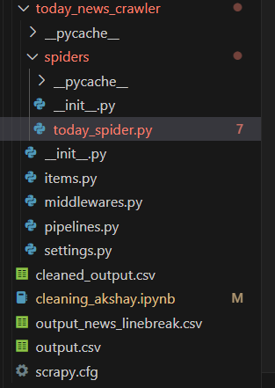
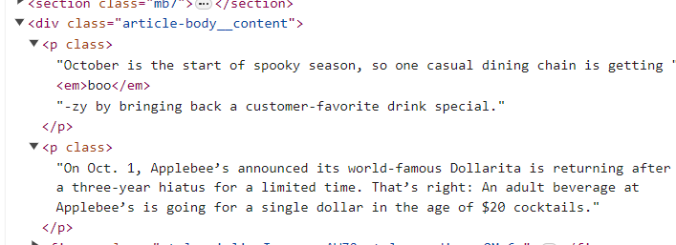
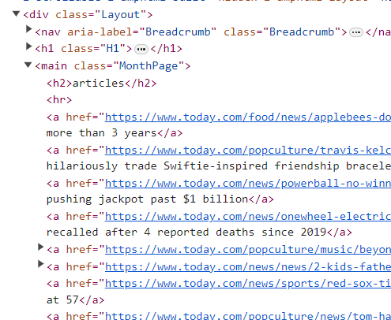
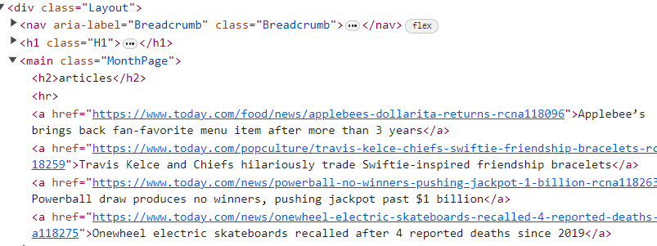

Scraping
Scrapy project is created.
Define Spider Name and Start URLs.
Define Parse Method.
Iterate Over Links in Main Section.
Make Requests to Links.
Define Parse Link Method.
Get the final output.
.
Notes:
Specify Spider Class:
Create a class named TodaySpider that inherits from scrapy.Spider.
Define Spider Name and Start URLs:
Set the name of the spider using the name attribute.
Provide a list of start URLs using the start_urls attribute.
Define Parse Method:
Implement the parse method to extract information from the HTML response.
Use XPath to select the main section with the class MonthPage.
Iterate Over Links in Main Section:
Use a loop to iterate over the <a> (anchor) elements within the main section.
Extract the link and title from each anchor element.
Make Requests to Links:
Use scrapy.Request to make requests to the extracted links.
Pass the link, callback method (parse_link), and title as metadata.
Define Parse Link Method:
Implement the parse_link method to extract content from the linked page.
Use XPath to select paragraphs (<p> elements) from the response.
Join Paragraphs and Yield Output:
Join the extracted paragraphs using "\n" to preserve line breaks.
Yield a dictionary containing link, title (from metadata), and the content.

Slide 5
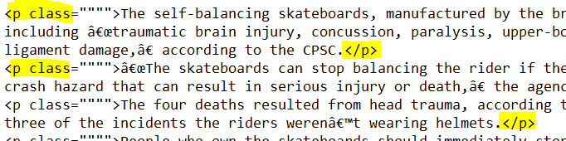
Scraping
Challenges :
Timeout error while scraping → Fixed by adding delay in scrapy settings.
Summarisation issues → Fixed by using xpath and getting the p tags during scraping .
Scraped Output :
:
Notes:
We did scraping initially and started with the data , but we faced some challenges with the summarization . So we decided to go back to scraping and use xpath instead of html tags and added all the <p> or paragraph tags in the scraped data .
We faced another issue where the website was blocking us from scraping after few requests , since we were using scrapy it was an easy fix by introducing delay in the requests.

Slide 6
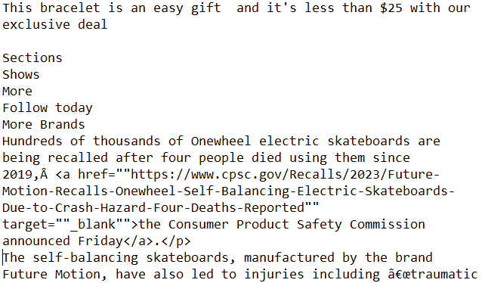
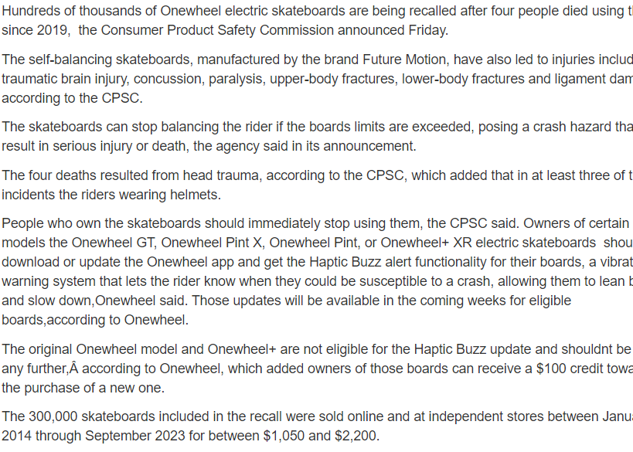
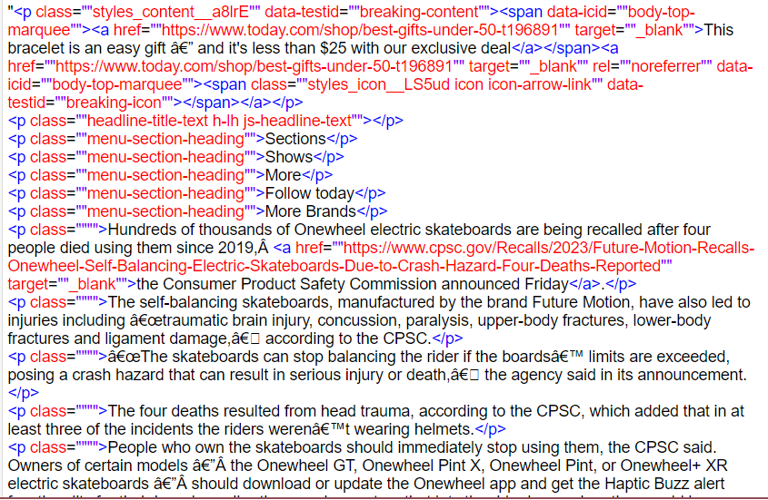
Data Cleaning
BeautifulSoup is used to extract only content .
Regex is used to remove the repeating unwanted lines .
One more round of cleaning for conditions such as empty text, specific classes, text starting with "©", or containing links, emojis.
Final output for sentiment analysis .

Slide 7
Sentiment Analysis – Model Card
Name:lxyuan/distilbert-base-multilingual-cased-sentiments-student
Purpose: To perform text classification tasks, such as sentiment analysis, emotion detection, topic classification, etc., on texts in 12 languages.
Model Architecture: distilled version of the BERT base multilingual model.
Fine-Tuning: Fine-tuned on the Multilingual Sentiment dataset using zero-shot distillation from another model called mDeBERTa-v3-base-mnli-xnli.
Technical Aspects: The model has 6 layers, 768 dimension and 12 heads, totalizing 134M parameters.
Limitations: Token limit is 512 . Can inherit bias from the teacher model .
Notes:
The teacher model for this model is MoritzLaurer/mDeBERTa-v3-base-mnli-xnli¹.
This is a multilingual model for natural language inference, The model is based on the DeBERTa-v3 architecture, which is an improved version of the BERT model that uses disentangled attention and relative position bias. The model is trained on the MNLI and XNLI datasets, which are large-scale datasets for natural language inference in multiple languages. The model can handle texts in 100 languages, and achieves state-of-the-art results on several natural language inference benchmarks². The model is used as a teacher model to transfer its knowledge and performance to the student model, which is distilbert-base-multilingual-cased-sentiments-student, using zero-shot distillation. This is a method that allows the student model to learn from the teacher model without using any labeled data³. The student model uses the hypothesis template "The sentiment of this text is {}." to generate the labels for the texts, and tries to mimic the outputs of the teacher model. The student model is a text classification model that can predict the sentiment of a text in 12 languages⁴.

Slide 8
Sentiment Analysis – How it Works
The cleaned data is passed to a tokenizer .
Tokenization (encoded_input): Encodes and truncates input text (only for sentiment analysis) , decodes truncated text finally .
Sentiment Analysis (sentiment_check): Uses "lxyuan/distilbert-base-multilingual-cased-sentiments-student" model, utilizes pipeline for sentiment analysis.
The output will include ‘positive’ or ‘negative’ label and a score .
Filtering Positive News (positive_news): Creates new DataFrame by filtering 'articles_short,' includes rows with 'positive' sentiment and score > 0.5.

Slide 9
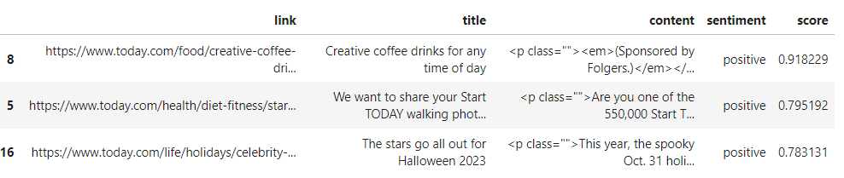
Sentiment Analysis – Output Example

Slide 10
Summarization – Model Card
Name: facebook/bart-large-cnn
Purpose: To make a summary of the positive news output from Sentiment Model
Model Architecture: BART Large Model pre-trained on the English Language.
Fine-Tuning: It has been specifically fine-tuned on a dataset derived from CNN Daily Mail
Technical Aspects: BART has more than 400M parameters, uses a standard seq2seq / machine translation architecture with a bidirectional encoder and a left-to-right decoder.
Limitations: 1024 tokens maximum input + all LLM limitations
Notes:
The training data of BART include Books and Stories, Wikipedia, News Articles, Websites, Other diverse text sources
By combining a bidirectional encoder with a left-to-right decoder, BART can effectively understand the context of the input data and generate coherent and contextually appropriate outputs. This architecture makes it suitable for a wide range of NLP tasks, including text summarization, translation, and content creation.
Bias in Training Data
Generalization Challenges
Interpretability and Explainability
Handling of Sarcasm and Subtle Language Nuances
Need for Continuous Updating

Slide 11
Summarization – How it Works
Purpose: Summarize the positive articles
Main variables: Output max and min length
Challenge: The token limit is 1024
Solution: Check if the sum of tokens for each text is more than 1024. If less, pass the full text to the dataframe. If more, merge the maximum possible number of paragraphs before 1024.
Challenge: The output text is not positive
Solution: Run the output through the sentiment analysis
Other Possible Concerns:
The remaining last part (paragraph) is too small for the summarizer.
Only 1 part of the text gives an error when summarized
Some positive “news” are sponsored content
Notes:
The training data of BART include Books and Stories, Wikipedia, News Articles, Websites, Other diverse text sources
By combining a bidirectional encoder with a left-to-right decoder, BART can effectively understand the context of the input data and generate coherent and contextually appropriate outputs. This architecture makes it suitable for a wide range of NLP tasks, including text summarization, translation, and content creation.
Bias in Training Data
Generalization Challenges
Interpretability and Explainability
Handling of Sarcasm and Subtle Language Nuances
Need for Continuous Updating

Slide 12
Summarization – Output Examples
Good example:
"Maya Hawke and her father, Ethan Hawke, recorded a song together. The father-daughter duo released a cover of Willie Nelsons We Dont Run. Maya Hawke has become a Gen Z ""it"" girl in her own right. The proud dad said he has been working with Maya Hawke since she was a little girl. ""She's always been gifted and we've always had an easy dialogue about art,"" he added.“
No context example:
"This drink is like the sophisticated, nuanced, all-grown-up version of chocolate milk. It's a fun and comforting way to start your day and get that much-needed jolt of caffeine.“
Notes:
The training data of BART include Books and Stories, Wikipedia, News Articles, Websites, Other diverse text sources
By combining a bidirectional encoder with a left-to-right decoder, BART can effectively understand the context of the input data and generate coherent and contextually appropriate outputs. This architecture makes it suitable for a wide range of NLP tasks, including text summarization, translation, and content creation.
Bias in Training Data
Generalization Challenges
Interpretability and Explainability
Handling of Sarcasm and Subtle Language Nuances
Need for Continuous Updating

Slide 13
Summarization – Output Examples
Sponsored content example:
"Beauty writer Candice Kumai shares some easy-going self-care products. Brooklinen's sateen set includes two pillowcases, a top and a fitted sheet. This multipurpose face mask is perfect for the skin care aficionado. The bubble massage mat from FORVR Mood massages, creates bubbles and even has a built-in heater. The intergalactic-themed bath bomb from Lush is loved by shoppers with over 600 five-star reviews."
Notes:
The training data of BART include Books and Stories, Wikipedia, News Articles, Websites, Other diverse text sources
By combining a bidirectional encoder with a left-to-right decoder, BART can effectively understand the context of the input data and generate coherent and contextually appropriate outputs. This architecture makes it suitable for a wide range of NLP tasks, including text summarization, translation, and content creation.
Bias in Training Data
Generalization Challenges
Interpretability and Explainability
Handling of Sarcasm and Subtle Language Nuances
Need for Continuous Updating

Slide 14
Plan – Existing and Future Work
Existing Work
Add error catching to fix some of the concerns on the existing code
Consider implementing a “fake news” model to filter out ads
Run tests with more data to test more possible scenarios
Future Work
Write the Flask application code
Design the web page
Research the deployment
Check metrics,
Make a list of possible improvements
Notes:
The training data of BART include Books and Stories, Wikipedia, News Articles, Websites, Other diverse text sources
By combining a bidirectional encoder with a left-to-right decoder, BART can effectively understand the context of the input data and generate coherent and contextually appropriate outputs. This architecture makes it suitable for a wide range of NLP tasks, including text summarization, translation, and content creation.
Bias in Training Data
Generalization Challenges
Interpretability and Explainability
Handling of Sarcasm and Subtle Language Nuances
Need for Continuous Updating

Slide 15
Thank You!

